Slide 1


Slide 2

The Clapper
Workshop 3 - Power

Slide 3
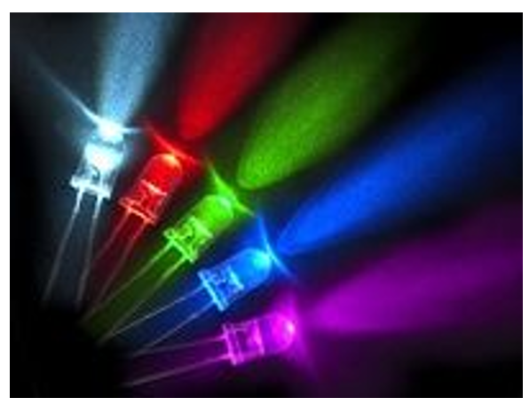
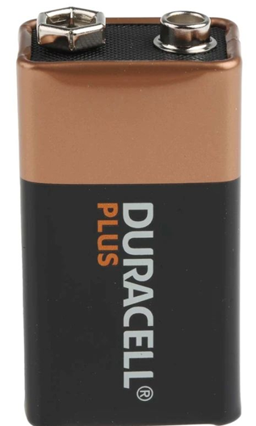
Power
We currently get power from the lab power supplies, we need to switch to powering from a battery
We currently turn on and off a single dim LED, that’s pretty boring…
Let’s upgrade to multiple LEDs and a let’s make them BRIGHT

Slide 4
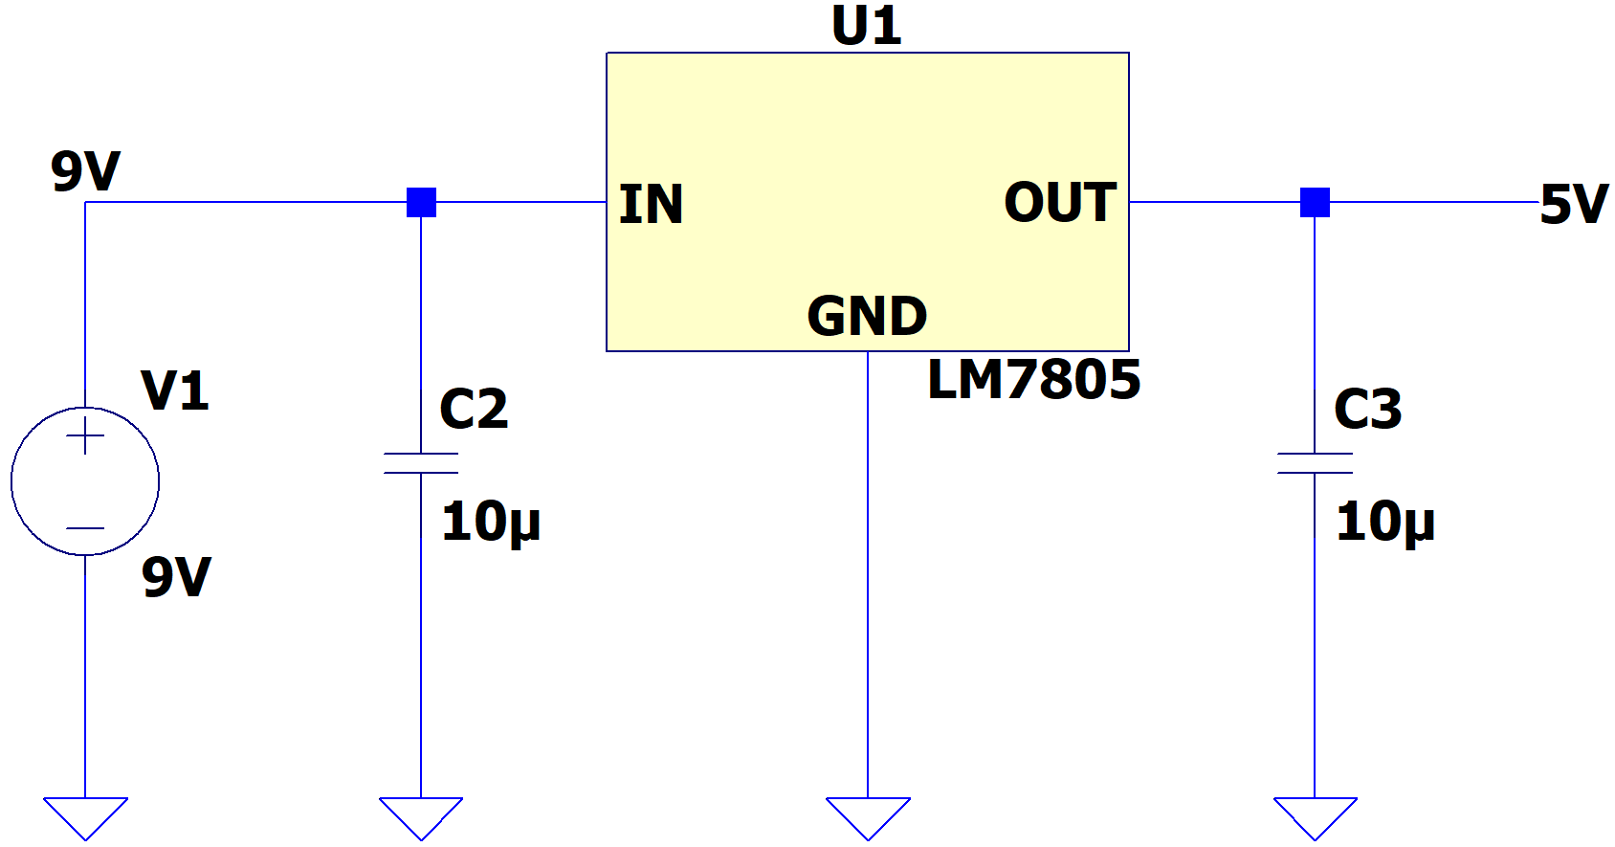
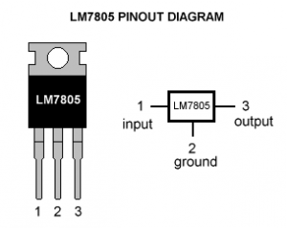
Voltage Regulation
Let’s step the 9V battery down to 5V to supply power the microcontroller and the op amp

Slide 5
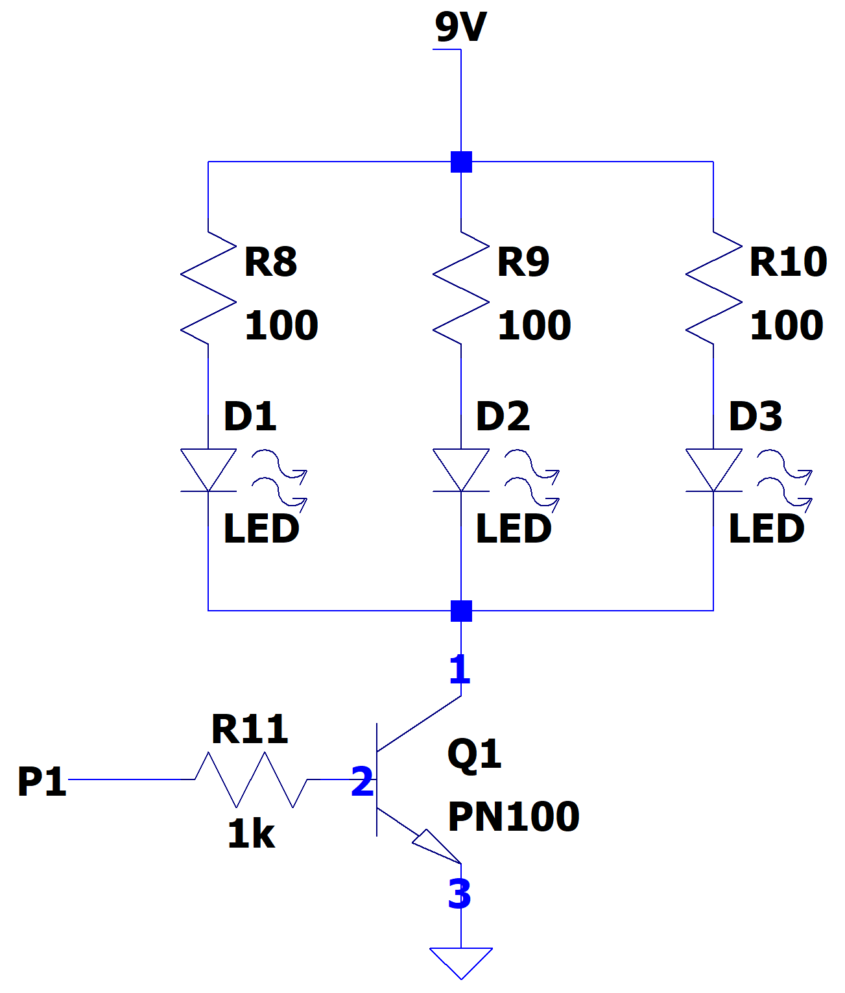
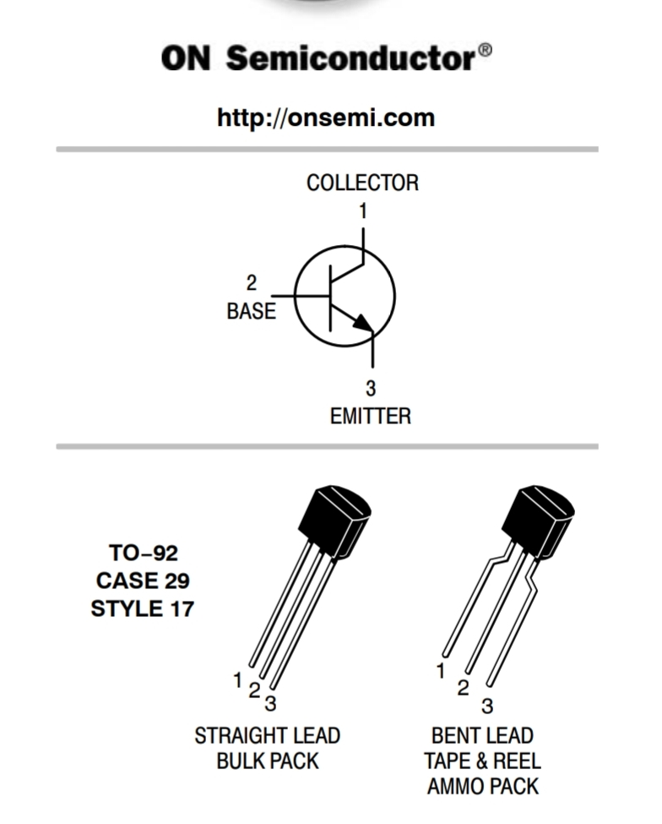
LED Setup
Let’s upgrade to 3 LEDs and make them bright using 9V!!!

Slide 6
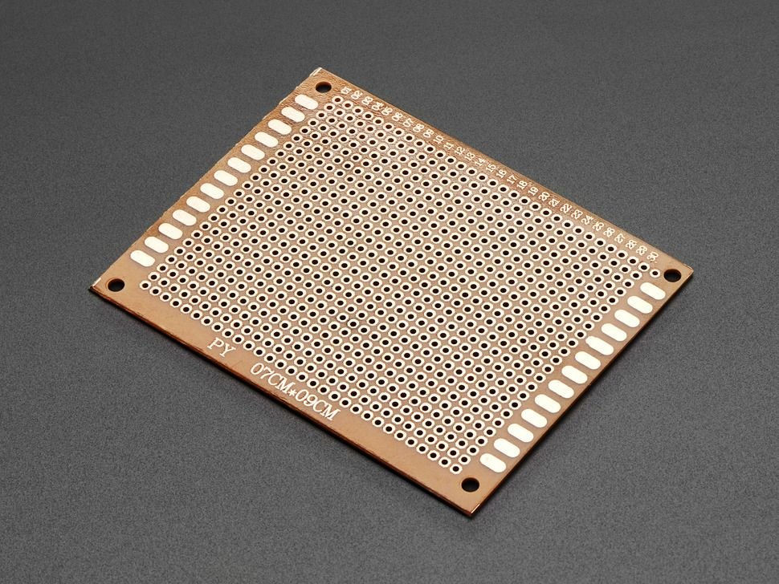
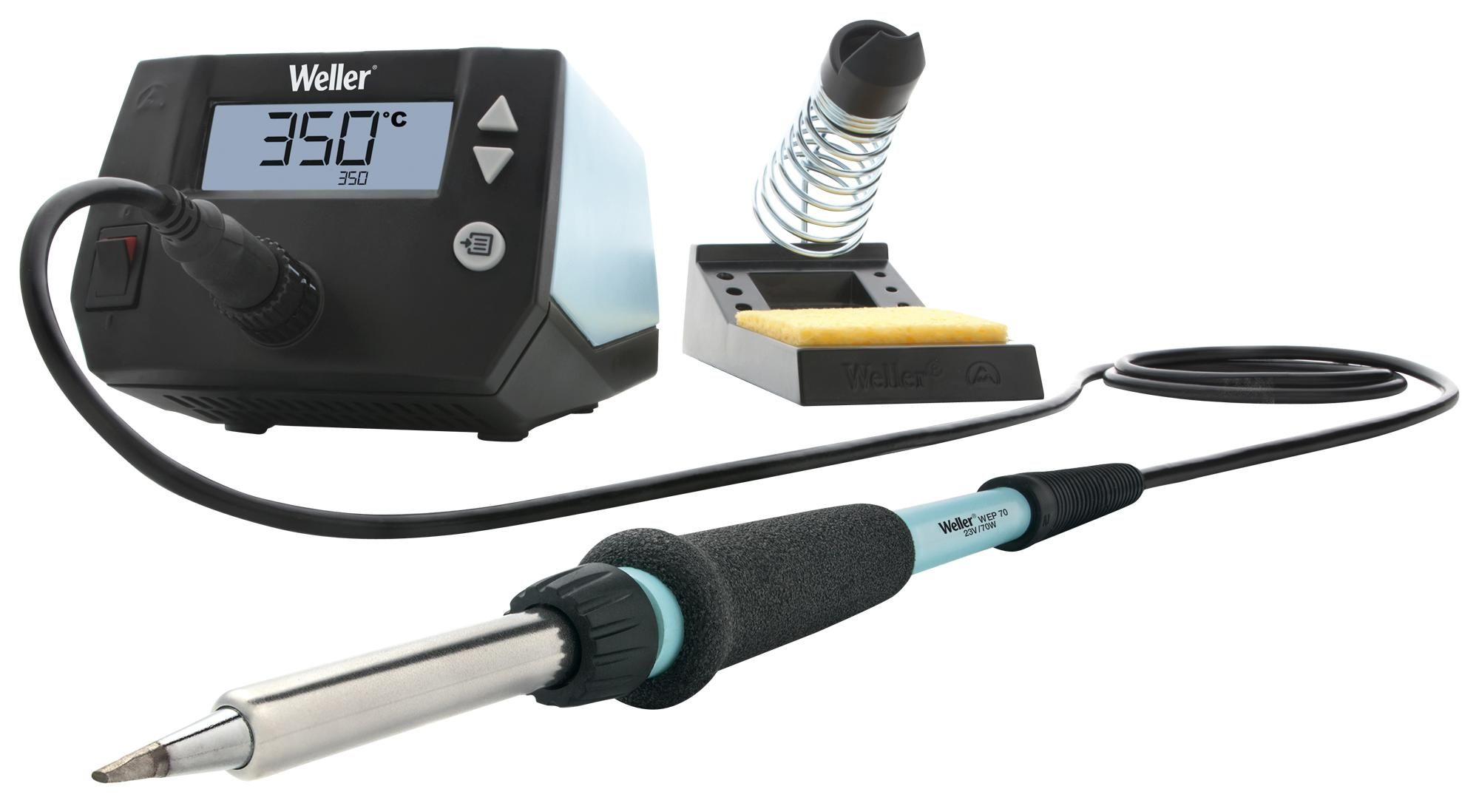
Next week
We are all done with the functionality of the clapper!
Let’s make it into something we can take home
Next week we will solder our creation onto perfboard
We will have a catch-up week in week 8 so don’t stress if you can’t make it
Be ready for Week 10 Showcase!!!

